Slide 2
Autonomous Vehicle Controls
Week 1
Classical controls overview

Slide 3
Table of Contents for the week
Autonomous vehicle
About the Course
Automotive Control System
System Modelling
Control System
Transient Performance
System Types
Disturbance Rejection and Tracking
PID Controller

Slide 4
Learning objectives
In this week, we will
Know about the autonomous vehicle industry
Learn about the controls Systems in Automotive Vehicle
Know how the controls react to input
How the system responds to disturbance
PID Controllers

Slide 5
Autonomous Vehicle

Slide 6
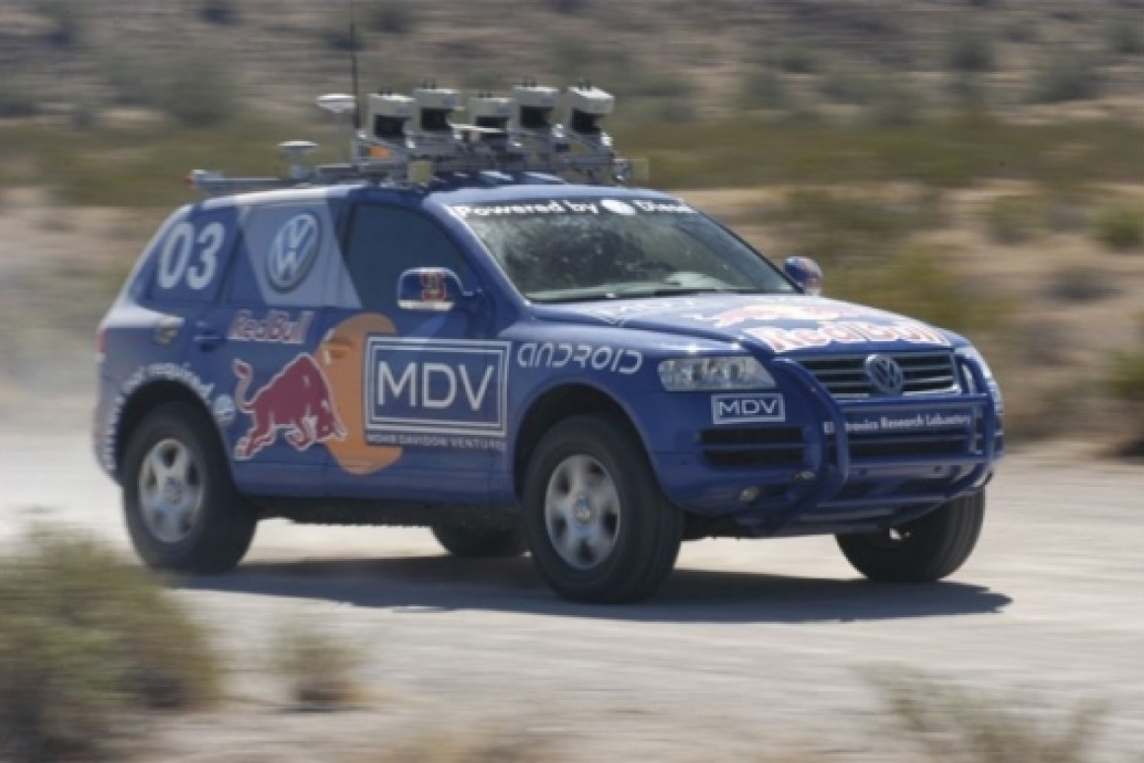
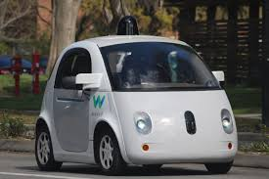
Autonomous vehicle motivation
The first major motivation started from the 2004 DARPA challenge won by Stanford.
Autonomous cars is set to add $2 trillion to US GDP through rideshare businesses and auto sales.
Notes:
Image 2 -https://www.google.com/url?sa=i&url=https%3A%2F%2Fcommons.wikimedia.org%2Fwiki%2FFile%3AWaymo_self-driving_car_front_view.gk.jpg&psig=AOvVaw06CzVVnkgb9oPzi2OuCIpI&ust=1608330255615000&source=images&cd=vfe&ved=0CAIQjRxqFwoTCKCQy6OH1u0CFQAAAAAdAAAAABAD

Slide 7
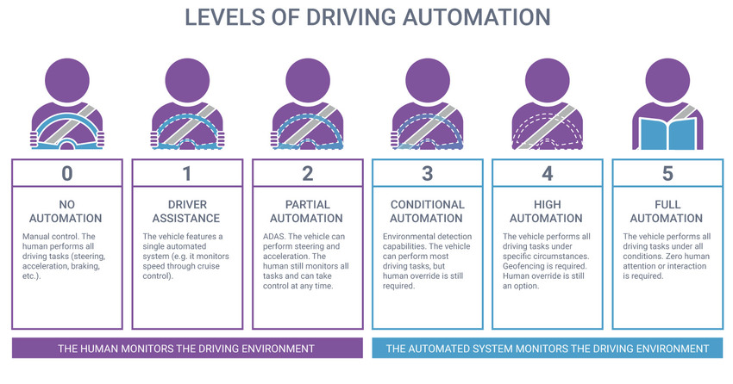
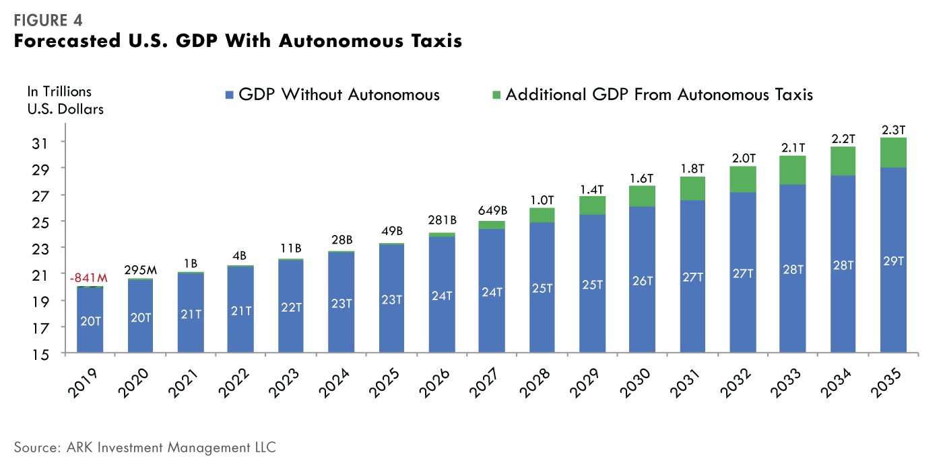
Autonomous vehicle motivation
Major OEMS such as Tesla, Ford, Volkswagen will have autonomous vehicles on production by 2022.
Autonomous ride sharing will solve urban mobility issues while reducing the number of accidents per year.

Slide 8
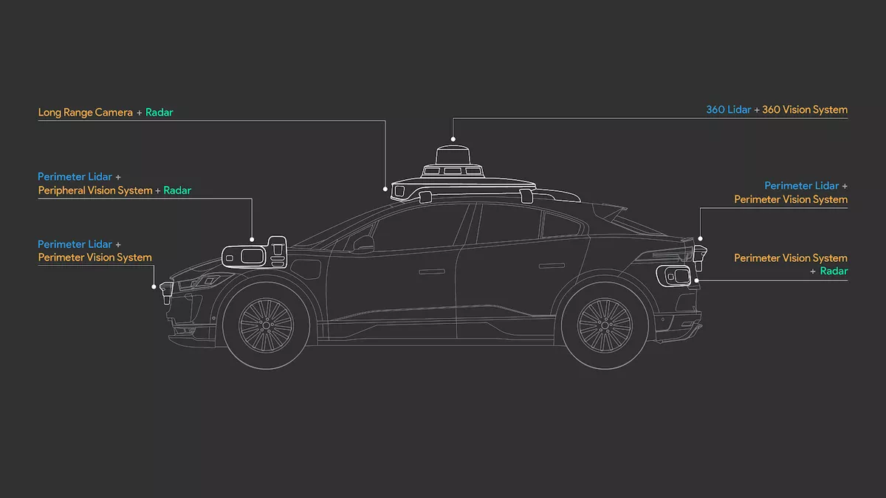
What makes an Autonomous vehicle?
An autonomous car is capable of sensing its environment and operating without human involvement.
Autonomous Vehicle Software stack:
Hardware
Sensors
Computing processors
Perception
Sensor processing
Sensor fusion
localization
Mapping
Action
Vehicle controls
Local Path planning
Behavioral Decisions
Notes:
Source- Pixabay
A: image 1 :https://www.google.com/url?sa=i&url=https%3A%2F%2Fwww.theverge.com%2F2020%2F3%2F4%2F21165014%2Fwaymo-fifth-generation-self-driving-radar-camera-lidar-jaguar-ipace&psig=AOvVaw1iKk7iu1pfGiwHJ9Lo9PqS&ust=1608330410265000&source=images&cd=vfe&ved=0CAIQjRxqFwoTCLCMqe-H1u0CFQAAAAAdAAAAABAJ
Image 2 : original from instructor’s simulink model

Slide 9
About the Course

Slide 10
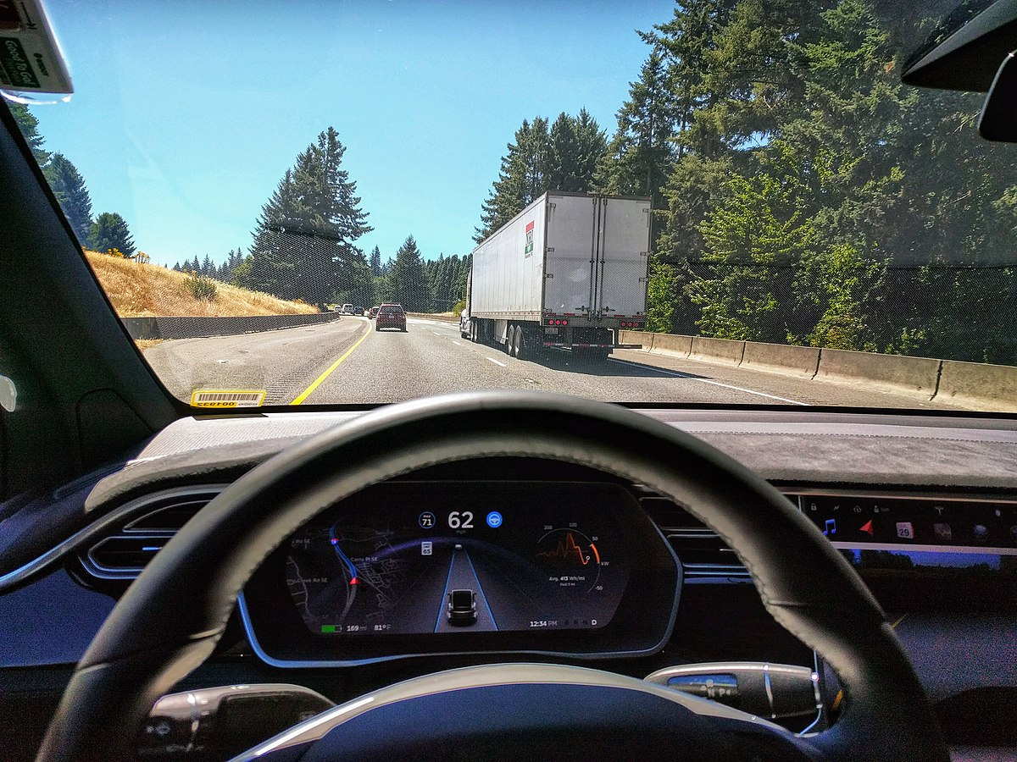
Course overview – What?
What do we learn in this course ?
Automotive vehicle controls for motion control in autonomous vehicles
Practical application of control systems to develop Level 2+ ADAS features. (ACC + LCA + Autopilot)
Model based design and implementation
1

Slide 11
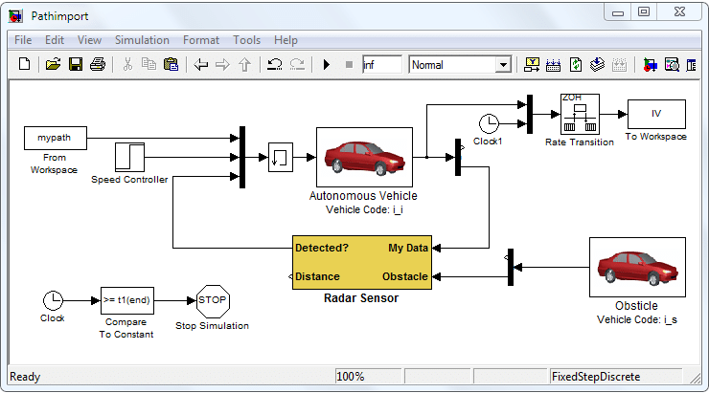
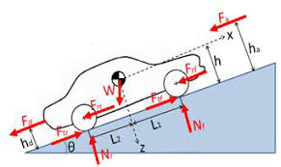
Course overview – How?
How do we do it?
Understand dynamics and control systems
Model algorithms using MATLAB / Simulink
Improve algorithms to add various functionalities to the feature
Notes:
Image 1 : original screenshot
Image 2 : https://www.google.com/url?sa=i&url=http%3A%2F%2Fmehanizacija.ftn.uns.ac.rs%2Fwp-content%2Fuploads%2F2017%2F07%2FPart-12.pdf&psig=AOvVaw0GU5_9Q23kzMZ7PTJBvi1R&ust=1608330761936000&source=images&cd=vfe&ved=0CAIQjRxqFwoTCMDAhJeJ1u0CFQAAAAAdAAAAABAE

Slide 12
Course overview – why?
Why are we learning this?
ADAS systems are the fastest growing segment in automotive electronics
Every OEM is fighting to the top for better autonomous vehicle technology
Extremely cool tech to build smarter vehicles

Slide 13
Prerequisite for this course
Hardware and Software tools:
MATLAB version preferably 2018b and above
Control system toolbox in MATLAB
Autonomous vehicle toolbox in MATLAB
Compatible PC requirements for MATLAB 2018b

Slide 14
Prerequisite for this course
Theory and background:
Linear algebra
Classical control systems basics
General knowledge about vehicle components and dynamics

Slide 15
Automotive control systems

Slide 16
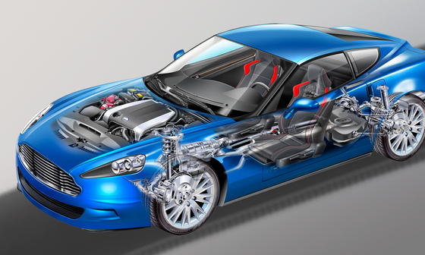
Powertrain Controls
Engine
Transmission
EGR
Throttle control
Spark control
Notes:
Instructions : create an image of the car and show the red boxes pointing to the engine, transmission

Slide 17
Vehicle Controls
ABS / brake controls
Steering control
Cruise control
Notes:
Instructions : create an image of the car and show the green boxes pointing to the steering, brakes

Slide 18
Body Control
Mirrors
Head lamps
Doors / Roof
Notes:
Instructions : create an image of the car and show the purple boxes pointing to the mirrors, headlight and doors

Slide 19
System Modelling

Slide 20
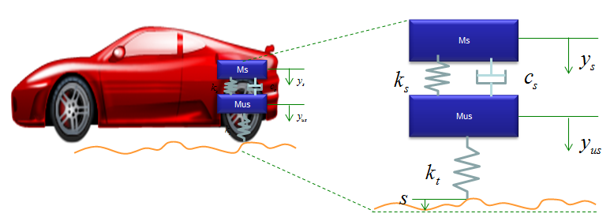
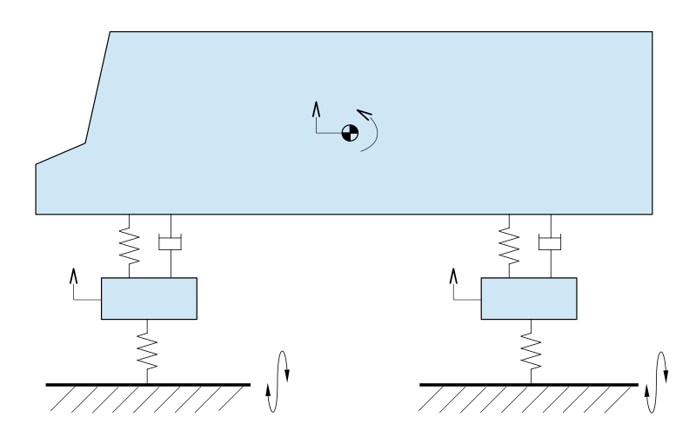
System modeling basics
Every dynamic system can be modelled into spring mass damper systems.
System modeling generates mathematical equations that can used to calculate control variables.
Image to be replaced with a recreated one.
2

Slide 21
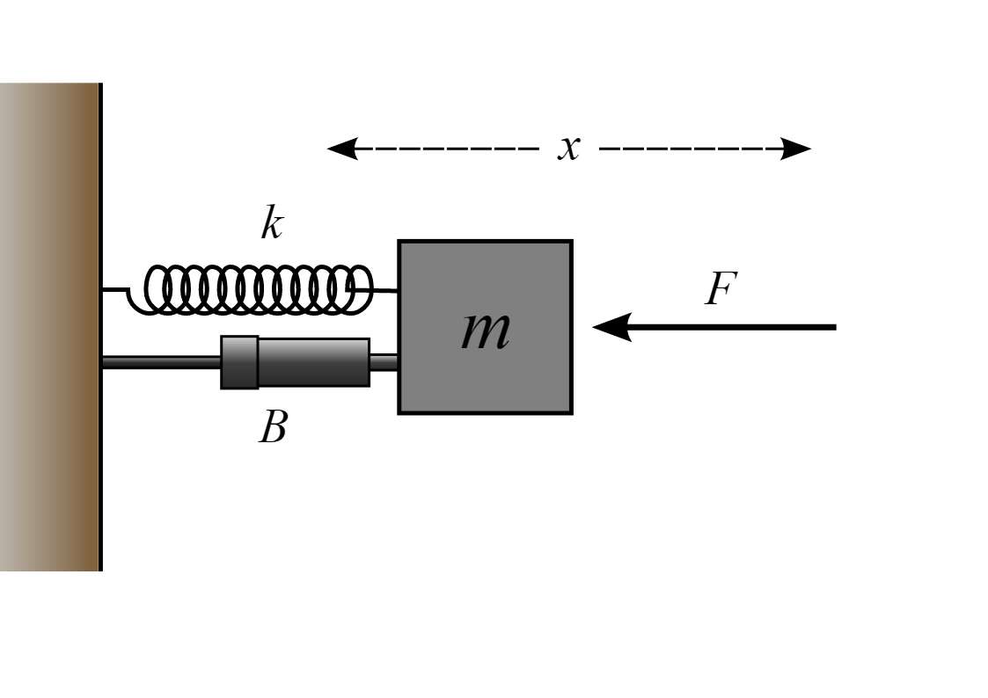
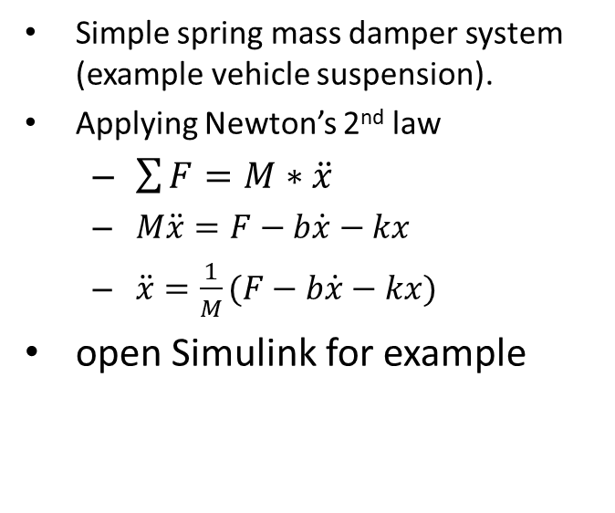
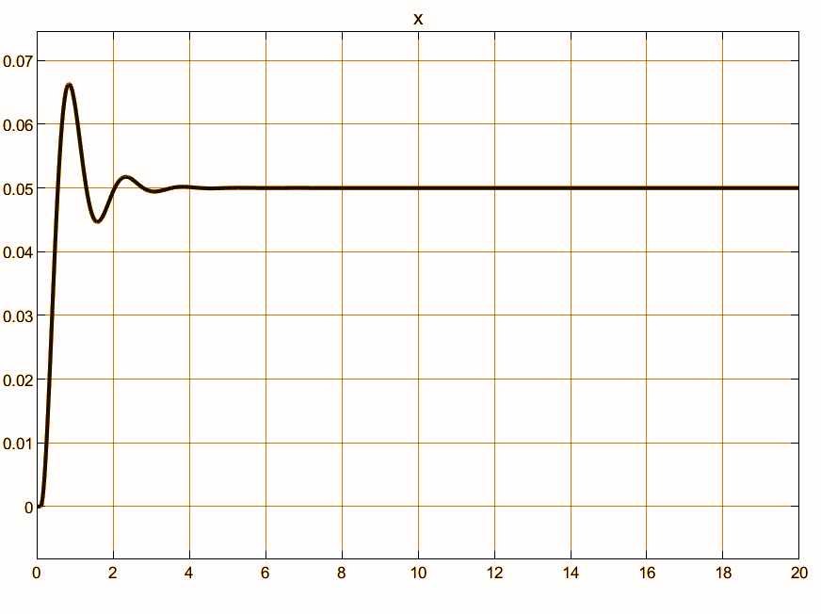
System modeling example
3

Slide 22
Control System

Slide 23
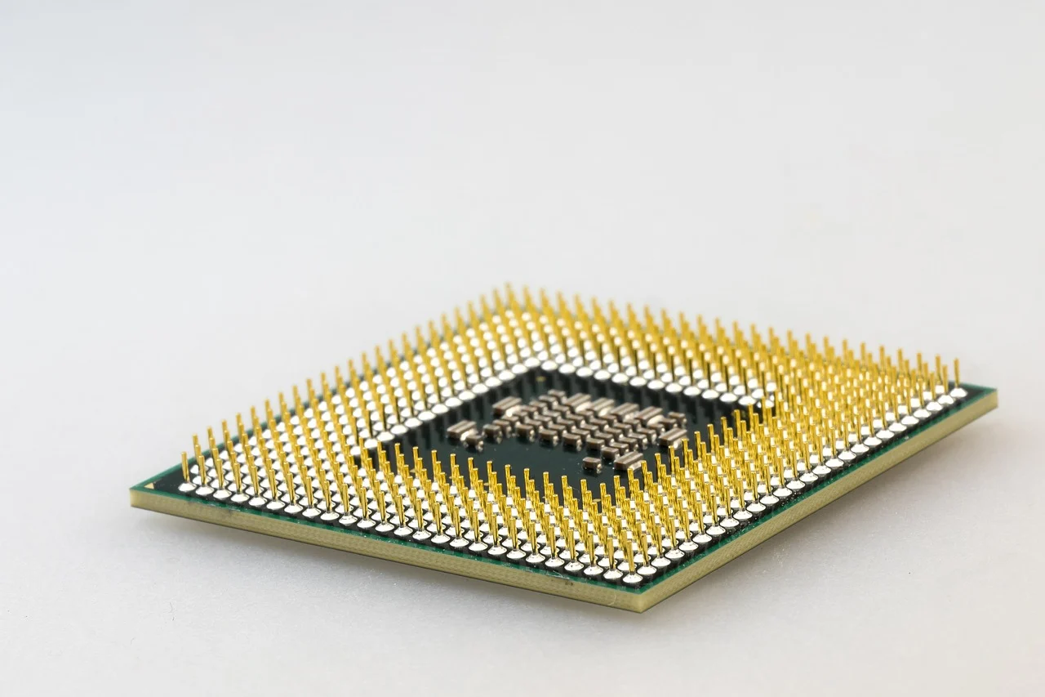
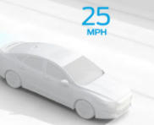
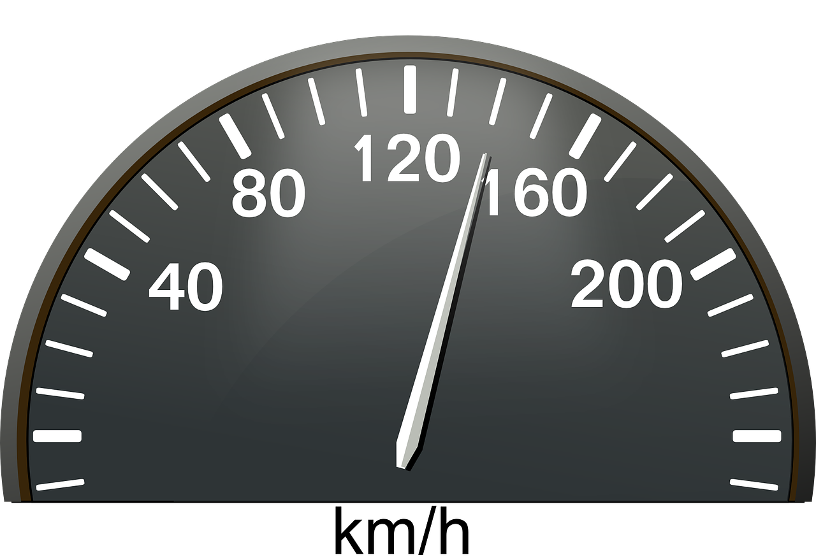
Control systems basics
Computation
Correction
Comparison
Controller
(ECU computer)
Actuator / Plant
(powertrain throttle body)0
Actual output
(actual speed)
+-
Desired output
Ex: cruise speed
Sensor
(wheel speed sensor)
Measurement
Notes:
Image 3 : car with speed 25mph. Image to be created should be a car with a vehicle speed on top.

Slide 24
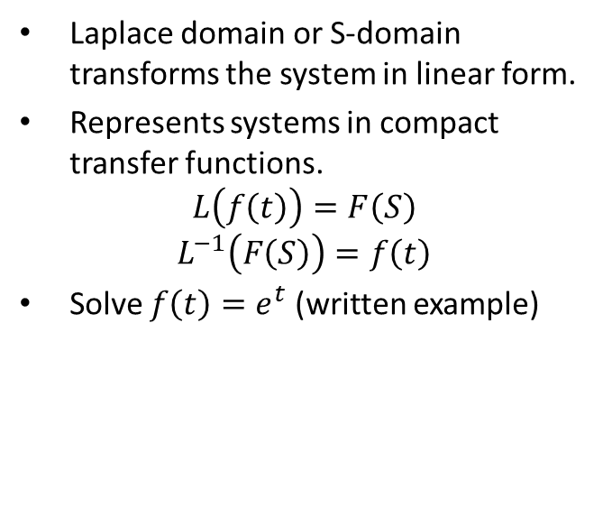
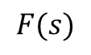
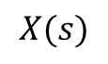
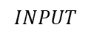
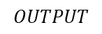
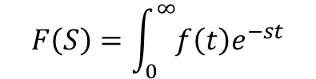
Laplace domain
TRANSFER FUNCTION

Slide 25
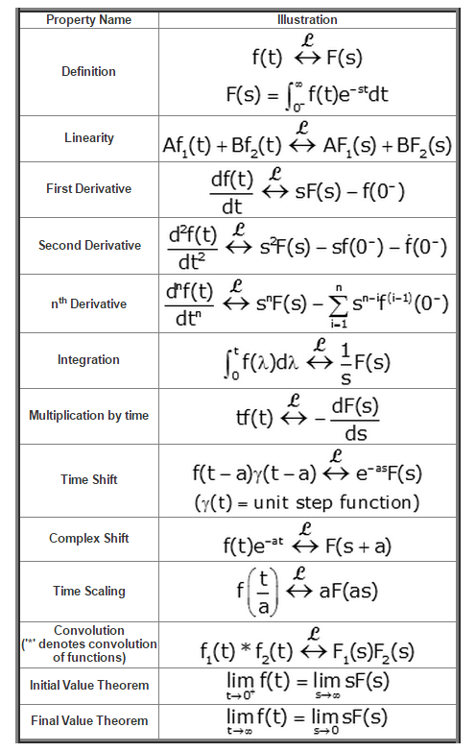
Laplace domain table

Slide 26
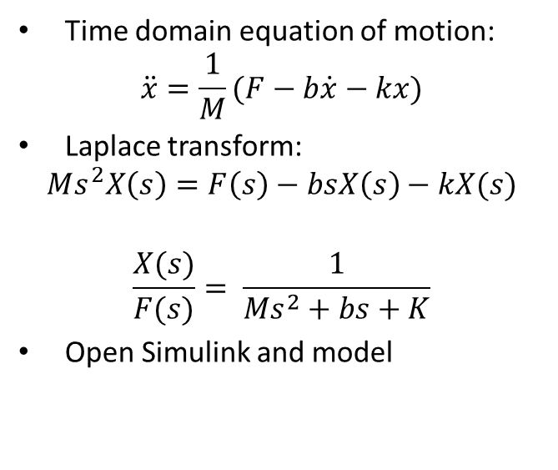
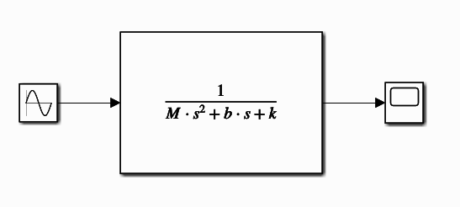
S domain example in Simulink
Notes:
A : the arrow for F force should be going the other side.

Slide 27
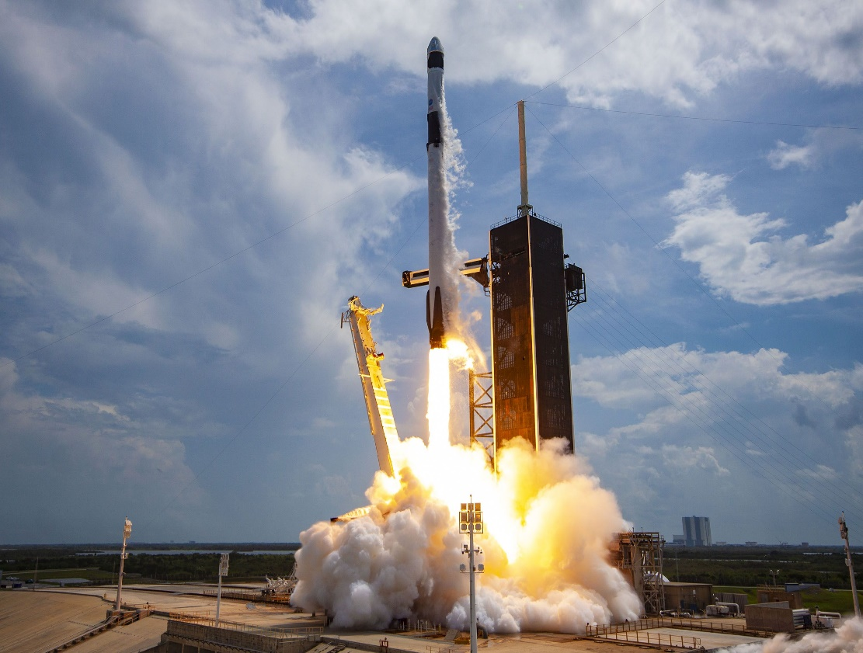
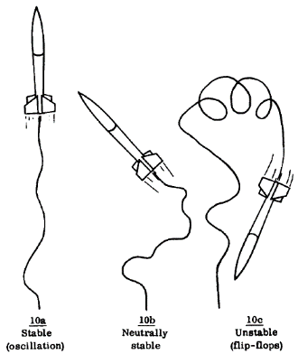
Classical control analysis
Control systems are designed to meet the following criteria
Stability
Transient performance
Disturbance rejection
Robustness
Control magnitude criteria
1
2
3
4
5
5
Notes:
Image 1 : need a rocket image to show unstability to match other examples

Slide 28
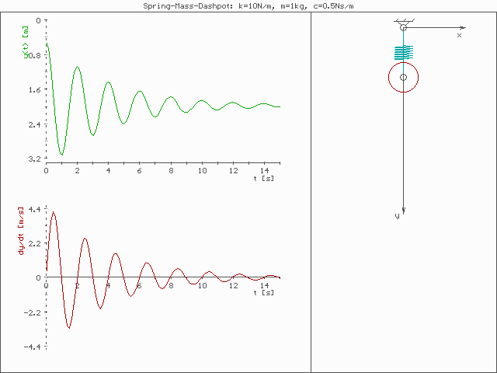
Stability
Properties of a stable system:
Initial condition response decays to zero as time goes to infinity
The forced response remains bounded when the input is bounded
Output decays to zero once input is turned off
6

Slide 29
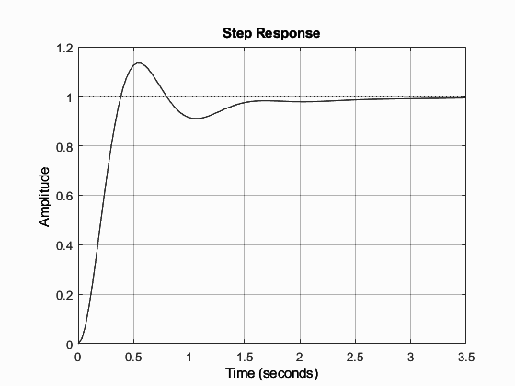
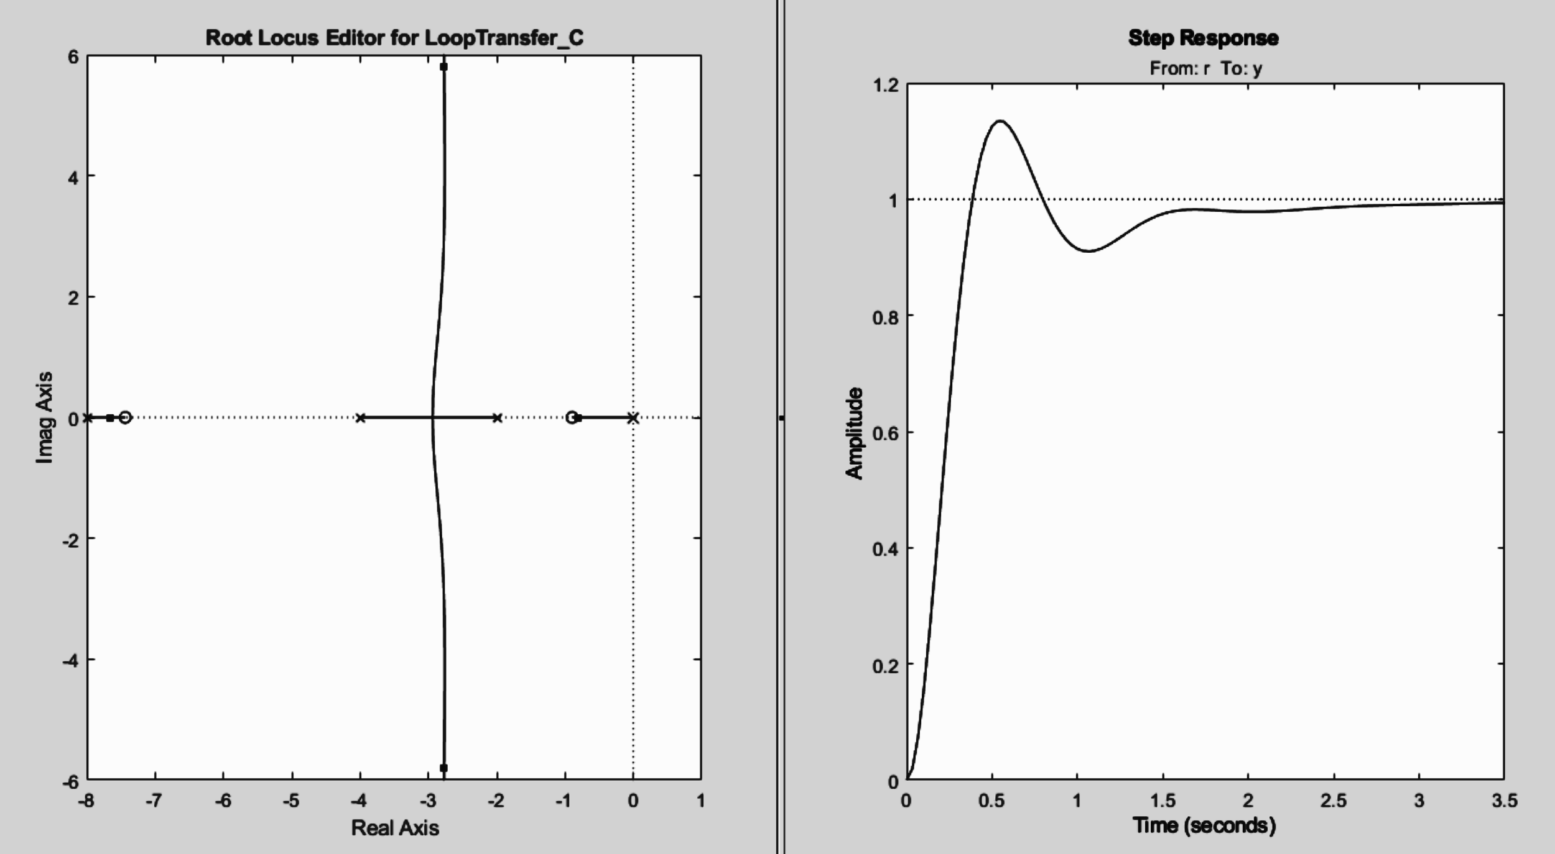
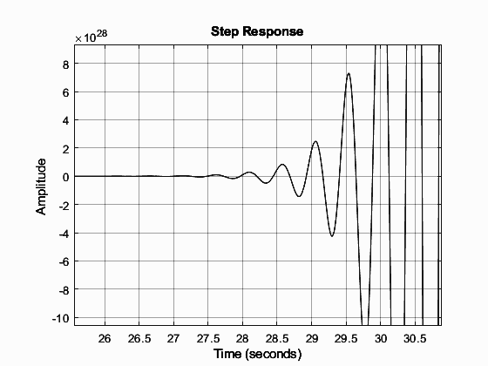
Example in MATLAB
Stable LTI system
Root locus showing poles and zeros of a stable LTI system
Unstable LTI system

Slide 30
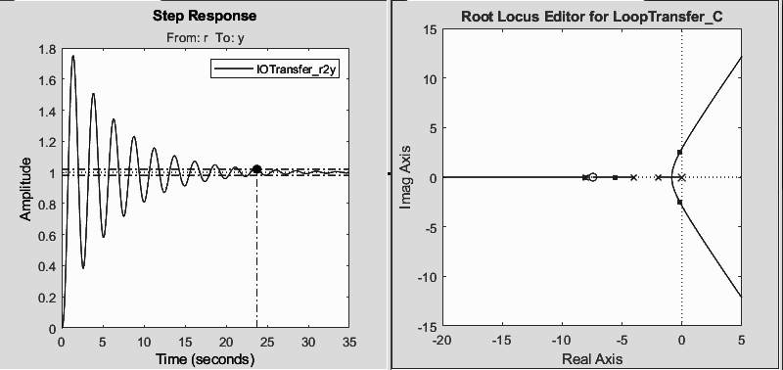
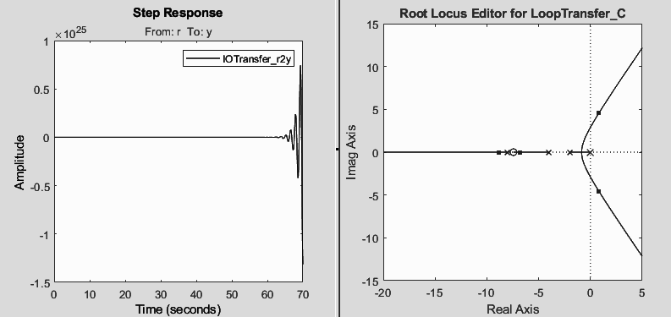
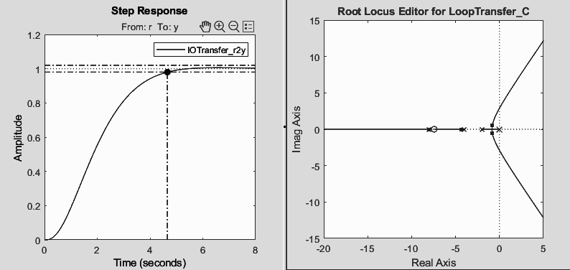
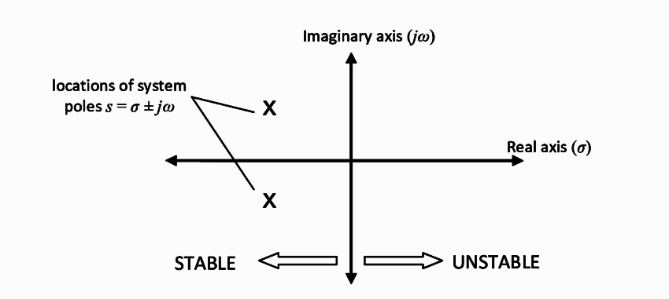
Root locus conclusion after demo
It is the locus of the roots of the characteristic equation by varying system gain K (usually proportional gain)from zero to infinity
As poles move up and down the imaginary axis the oscillating frequency increases
As poles move to the left along the real axis the rate of exponential decay increases
As poles move right of the imaginary axis rate of exponential growth increases (unstable)

Slide 31
Transient Performance

Slide 32
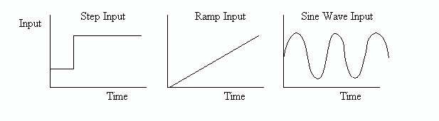
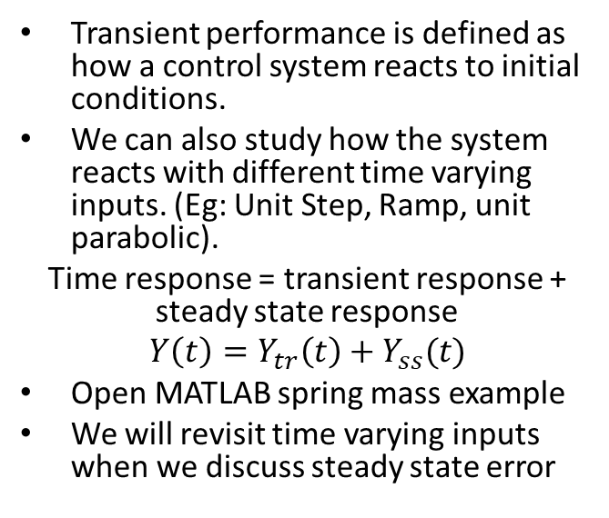
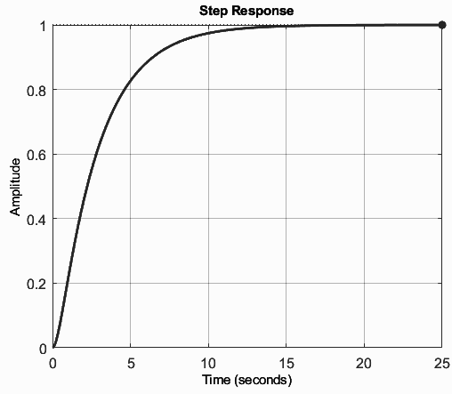
Transient performance

Slide 33
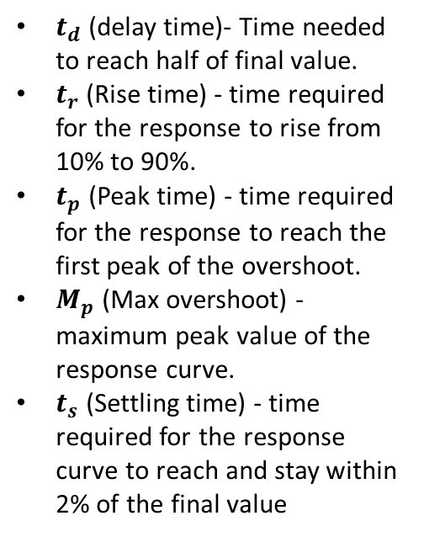
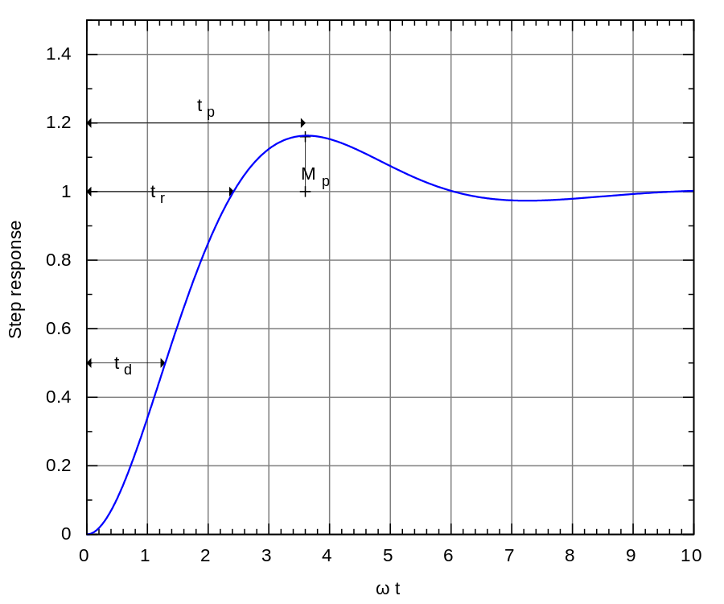
Transient performance specifications

Slide 34
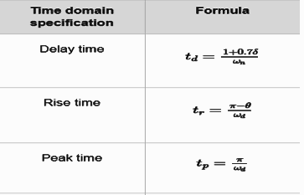
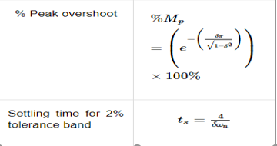
Formulas for transient response specifications
Time Domain Specification | Formula
Delay Time
Rise Time
Peak Time
4
ઠω_{n}
%Peak Overshoot
Setting time for 2% tolerance band | ts =
4
ઠω_{n}

Slide 35
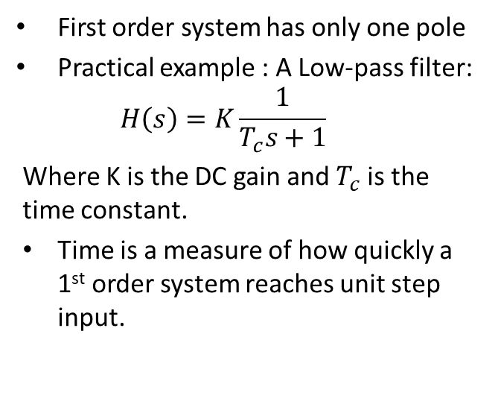
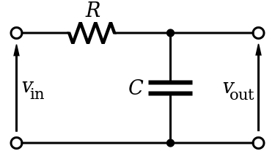
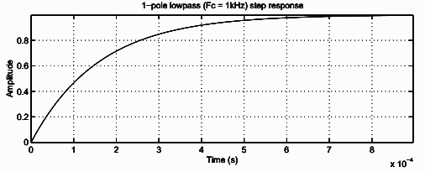
Transient performance : First order pole system
7

Slide 36
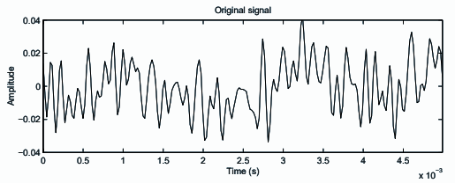
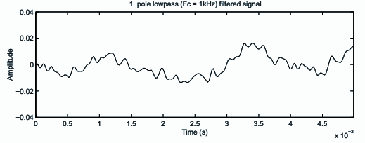
First order practical example
Observe low pass filter example in MATLAB

Slide 37
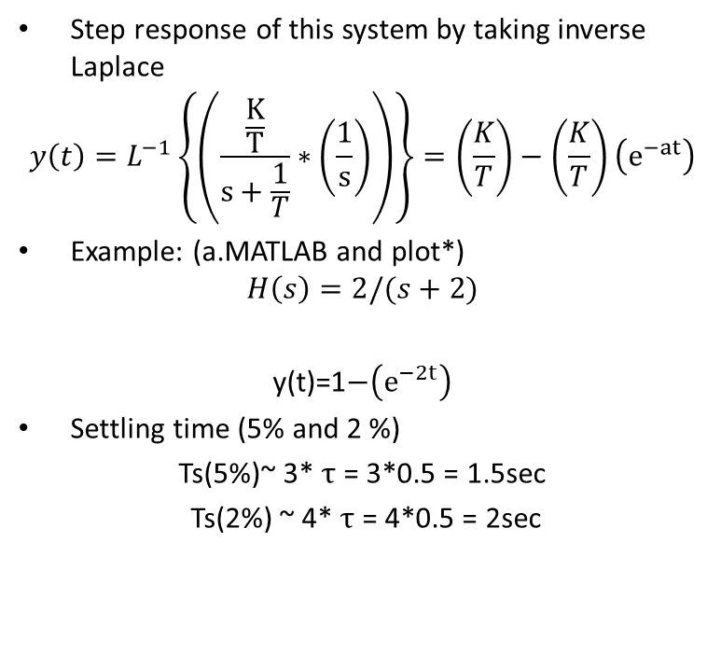
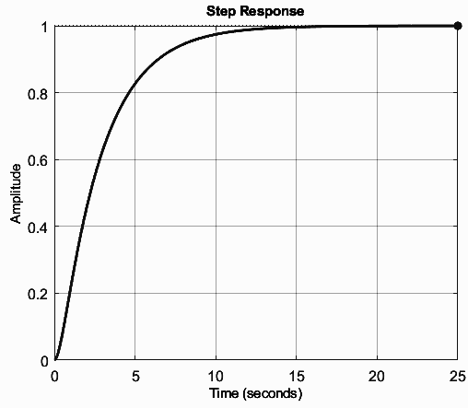
First order Continued

Slide 38


Transient performance : Second order pole system
Image to be recreated

Slide 39


Second order example in MATLAB
Step response
0.3
0.25
0.2
0.15
0.1
0.05
0
Amplitude
%Mp = 8.1%
Tr = 0.296s
Ts = 1.03s
0 0.5 1 1.5 2 2.5
Time (seconds)

Slide 40
System Types

Slide 41


Steady state error
Steady-state error is defined as the difference between the input (command) and the output of a system in the limit as time goes to infinity.
Note: Steady state error analysis is only useful for stable system.

Slide 42

System Type
System type tells us how a transfer function will respond in steady state with respect to an input (reference input or disturbance input).
Example let’s say we have a Type 1 system with respect to R.(by hand).

Slide 43


How to analyze system type

Slide 44
System type summary
System type helps to determine whether the steady state error is 0, finite, or infinite for a particular input (step, impulse, parabola etc.).
System type can be increased by adding an integrator to a controller.
Steady state error results involving system type apply only to unity feedback systems. Non unity feedback systems resolve into unity systems and then solve them.

Slide 45
Disturbance rejection and tracking

Slide 46

Disturbance rejection and tracking
Disturbance rejection analysis is the ability of a closed loop system to ignore external disturbances. (Ex: wind turbulence on rocket, down hill in cruise control)
Tracking analysis is a measure of how closely a system output follows reference input
We will study this closely during lateral control lectures
Wind as disturbance

Slide 47

Disturbance rejection and tracking analysis with step inputs (hand calculation)

Slide 48

Disturbance rejection and tracking analysis with step input

Slide 49

Other common controls concepts to consider
Control magnitude
Must be within system limitations
Ex: Rocket engine has limited thrust capacity hence the control input cannot cross above that. (ex: max thrust 6806kN)
Robustness :
A system is robust if the performance specifications are met in the presence of parameter variations within defined range.
Ex: The rocket control system must be able to operate in different payloads within defined range. (ex: 22800 kg +/ 5500 kg)
SpaceX falcon 9 has a payload capacity of 22800 kg expandable to +5500 for geostationary orbits.
SpaceX falcon 9 has a maximum thrust capacity of 6806kN at liftoff
Notes:
Image source https://pixabay.com/photos/rocket-launch-rocket-space-shuttle-67649/

Slide 50
PID Controller

Slide 51




PID Controller
PID controller algorithm: Proportional (P); Integral (I); Derivative (D)
P = depends on the present error
I = accumulation of past errors
D = prediction of future errors
PID used in ADAS
PID used in automation
PID used in robotics
9
8
PID used in throttle body
10

Slide 52

PID Controllers

Slide 53

Building a PID system in Simulink
Consider the mass spring damper example and model in Simulink
Mass = 1kg;
K = 10 N/m;
B = 20 Ns/m
To be recreated

Slide 54

PID controllers summarized
Proportional:
Speeds up the response (reduces rise time)
As Kp increases
%Mp overshoot increases (oscillations increases)
pushes system towards instability
Improves steady state tracking
Amplitude
Time

Slide 55

PID controllers summarized
PD (Proportional plus derivative):
PD control adds sort of a damping.
Disturbance rejection and tracking may be improved.
Large derivative gains are often difficult to realize in proactive due to large sensor noise
Amplitude
Time

Slide 56
PID controllers summarized
Proportional plus integral (PI) :
PI control can improve both disturbance rejection and tracking performance
Large integral gains can make the system go unstable, usually more easily than a simple P controller
PI control may result in larger settling time and high overshoot. (also sometimes known as integrator wind-up error)
Amplitude
Time

Slide 57

PID controllers summarized
Proportional integral and derivative (PID):
Tracking & disturbance rejection is usually better due to integral term
Derivative gains may need to be made lower than theoretical values due to sensor noise
PID tuning is a tricky process. There are several ways like Trial and error , Ziegler-Nichols, twiddle algorithm
Amplitude
Time

Slide 58
Rule of thumb with PIDs
Gain Values | Rise time | Overshoot | Settling time | Ess
Kp | Decrease | Increase | Small change | Decrease
Ki | Decrease | Increase | Increase | Decrease
Kd | Small Change | Decrease | Decrease | No change

Slide 59
PID auto tuning with Twiddle algorithm
Twiddle is an optimization algorithm that tries to find a good choice of parameters p for an algorithm A that return an error
Use trial and error to determine parameter vector P and initialize twiddle algorithm
Follow the iterative process to make small value change either positive and negative & If there is improvement the change is kept until the error is below the threshold

Slide 60

PID auto tuning with Twiddle algorithm
To be recreated

Slide 61
Summary
This week, we learned
About the controls of autonomous vehicles
How the system the system is modelled
The control system of autonomous vehicle
How a system type is analyzed
How disturbances from the surroundings are tackled
Relevance of PID controllers

Slide 62
Image Credits
Ian Maddox, CC BY-SA 4.0 <https://creativecommons.org/licenses/by-sa/4.0>, via Wikimedia Commons
Yapparina, CC0, via Wikimedia Commons
No machine-readable author provided. Ilmari Karonen assumed (based on copyright claims)., Public domain, via Wikimedia Commons
Olivier Cleynen and Werneuchen, CC0, via Wikimedia Commons
NASA/Joel Kowsky, Public domain, via Wikimedia Commons
Pasimi, CC BY-SA 4.0 <https://creativecommons.org/licenses/by-sa/4.0>, via Wikimedia Commons
Inductiveload, Public domain, via Wikimedia Commons
Magnus Bäck, Public domain, via Wikimedia Commons
Eirik Refsdal from Trondheim, NORWAY, CC BY 2.0 <https://creativecommons.org/licenses/by/2.0>, via Wikimedia Commons
Phasmatisnox, CC BY 3.0 <https://creativecommons.org/licenses/by/3.0>, via Wikimedia Commons

Slide 63
THANK YOU

